Slide 1

Lecture 03 Part 1
Application Layer
Computer Networking: A Top Down Approach
7th edition
Jim Kurose, Keith Ross
Pearson/Addison Wesley
April 2016
Application Layer
2-<number>

Slide 2
User-server state: cookies
example:
Susan always access Internet from PC
visits specific e-commerce site for first time
when initial HTTP requests arrives at site, site creates:
  unique ID
  entry in backend database for ID
many Web sites use cookies
four components:
  1) cookie header line of HTTP response message
  2) cookie header line in next HTTP request message
  3) cookie file kept on user’s host, managed by user’s browser
  4) back-end database at Web site
Application Layer
2-<number>

Slide 3

Cookies: keeping “state” (cont.)
client
server
ebay 8734
usual http request msg
Amazon server
creates ID
1678 for user
cookie file
usual http response
set-cookie: 1678
backend
database
create
entry
ebay 8734
amazon 1678
usual http request msg
cookie: 1678
cookie-
specific
action
access
usual http response msg
one week later:
access
ebay 8734
amazon 1678
usual http request msg
cookie: 1678
cookie-
specific
action
usual http response msg
Application Layer
2-<number>

Slide 4
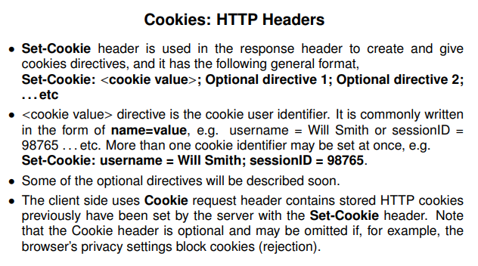

Slide 5
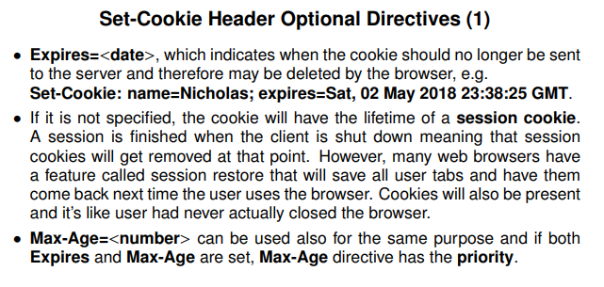

Slide 6
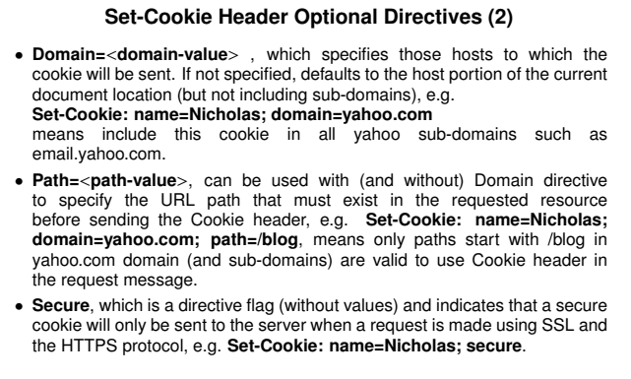

Slide 7
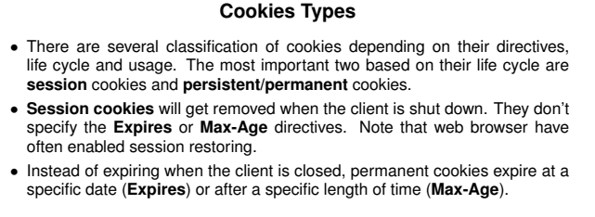

Slide 8
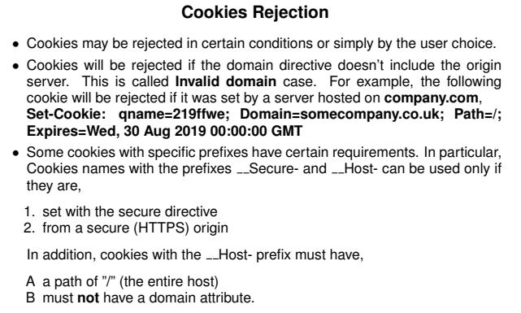

Slide 9
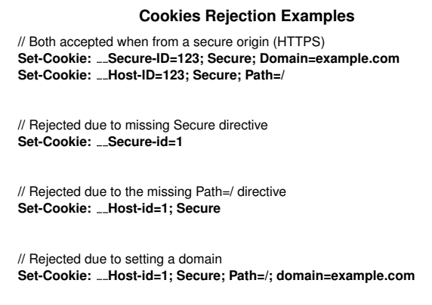

Slide 10
Cookies (continued)
aside
what cookies can be used for:
authorization
shopping carts
recommendations
user session state (Web e-mail)
cookies and privacy:
cookies permit sites to learn a lot about you
you may supply name and e-mail to sites
how to keep “state”:
protocol endpoints: maintain state at sender/receiver over multiple transactions
cookies: http messages carry state
Application Layer
2-<number>

Slide 11
Chapter 2: outline
2.1 principles of network applications
2.2 Web and HTTP
2.3 electronic mail
  SMTP, POP3, IMAP
2.5 P2P applications
Application Layer
2-<number>

Slide 12
Electronic mail
outgoing
message queue
user mailbox
Three major components:
user agents
mail servers
simple mail transfer protocol: SMTP
User Agent
a.k.a. “mail reader”
composing, editing, reading mail messages
e.g., Outlook, Thunderbird, iPhone mail client
outgoing, incoming messages stored on server
user
agent
mail
server
user
agent
SMTP
mail
server
user
agent
SMTP
SMTP
user
agent
mail
server
user
agent
user
agent
Application Layer
2-<number>

Slide 13
Electronic mail: mail servers
mail servers:
mailbox contains incoming messages for user
message queue of outgoing (to be sent) mail messages
SMTP protocol between mail servers to send email messages
  client: sending mail server
  “server”: receiving mail server
user
agent
mail
server
user
agent
SMTP
mail
server
user
agent
SMTP
SMTP
user
agent
mail
server
user
agent
user
agent
Application Layer
2-<number>

Slide 14
Electronic Mail: SMTP [RFC 2821]
uses TCP to reliably transfer email message from client to server, port 25
direct transfer: sending server to receiving server
three phases of transfer
  handshaking (greeting)
  transfer of messages
  closure
command/response interaction (like HTTP)
  commands: ASCII text
  response: status code and phrase
messages must be in 7-bit ASCI
Application Layer
2-<number>

Slide 15


Scenario: Alice sends message to Bob
1) Alice uses UA to compose message “to” bob@someschool.edu
2) Alice’s UA sends message to her mail server; message placed in message queue
3) client side of SMTP opens TCP connection with Bob’s mail server
4) SMTP client sends Alice’s message over the TCP connection
5) Bob’s mail server places the message in Bob’s mailbox
6) Bob invokes his user agent to read message
user
agent
mail
server
user
agent
1
mail
server
2
3
6
4
Alice’s mail server
5
Bob’s mail server
Application Layer
2-<number>

Slide 16
SMTP: final words
SMTP uses persistent connections
SMTP requires message (header & body) to be in 7-bit ASCII
SMTP server uses CRLF.CRLF to determine end of message
comparison with HTTP:
HTTP: pull
SMTP: push
both have ASCII command/response interaction, status codes
HTTP: each object encapsulated in its own response message
SMTP: multiple objects sent in multipart message
Application Layer
2-<number>

Slide 17
Mail message format
SMTP: protocol for exchanging email messages
RFC 822: standard for text message format:
header lines, e.g.,
  To:
  From:
  Subject:
  different from SMTP MAIL FROM, RCPT TO: commands!
Body: the “message”
  ASCII characters only
header
blank
line
body
Application Layer
2-<number>

Slide 18
Mail access protocols
user
agent
mail access
protocol
user
agent
SMTP
SMTP
(e.g., POP,
IMAP)
sender’s mail
server
receiver’s mail
server
SMTP: delivery/storage to receiver’s server
mail access protocol: retrieval from server
  POP: Post Office Protocol [RFC 1939]: authorization, download
  IMAP: Internet Mail Access Protocol [RFC 1730]: more features, including manipulation of stored messages on server
  HTTP: gmail, Hotmail, Yahoo! Mail, etc.
Application Layer
2-<number>

Slide 19
POP3 protocol
S: +OK POP3 server ready
C: user bob
S: +OK
C: pass hungry
S: +OK user successfully logged on
authorization phase
client commands:
  user: declare username
  pass: password
server responses
  +OK
  -ERR
transaction phase, client:
list: list message numbers
retr: retrieve message by number
dele: delete
quit
C: list
S: 1 498
S: 2 912
S: .
C: retr 1
S: <message 1 contents>
S: .
C: dele 1
C: retr 2
S: <message 1 contents>
S: .
C: dele 2
C: quit
S: +OK POP3 server signing off
Application Layer
2-<number>

Slide 20
POP3 (more) and IMAP
more about POP3
previous example uses POP3 “download and delete” mode
  Bob cannot re-read e-mail if he changes client
POP3 “download-and-keep”: copies of messages on different clients
POP3 is stateless across sessions
IMAP
keeps all messages in one place: at server
allows user to organize messages in folders
keeps user state across sessions:
  names of folders and mappings between message IDs and folder name
Application Layer
2-<number>

Slide 21
Chapter 2: outline
2.1 principles of network applications
2.2 Web and HTTP
2.3 electronic mail
  SMTP, POP3, IMAP
2.5 P2P applications
Application Layer
2-<number>

Slide 22

















Pure P2P architecture
no always-on server
arbitrary end systems directly communicate
peers are intermittently connected and change IP addresses
examples:
  file distribution (BitTorrent)
  Streaming (KanKan)
  VoIP (Skype)
Application Layer
2-<number>

Slide 23
File distribution: client-server vs P2P
Question: how much time to distribute file (size F) from one server to N peers?
  peer upload/download capacity is limited resource
u_{s}: server upload capacity
u₁
d_{i}: peer i download capacity
file, size F
u_{s}
d₁
u₂
d₂
server
d_{i}
u_{N}
network (with abundant
bandwidth)
u_{i}
d_{N}
u_{i}: peer i upload capacity
Application Layer
2-<number>

Slide 24
File distribution time: client-server
server transmission: must sequentially send (upload) N file copies:
  time to send one copy: F/u_{s}
  time to send N copies: NF/u_{s}
F
u_{s}
d_{i}
network
u_{i}
client: each client must download file copy
  d_{min} = min client download rate
  min client download time: F/d_{min}
time to distribute F
to N clients using
client-server approach
D_{c-s} > max{NF/u_{s,},F/d_{min}}
increases linearly in N
Application Layer
2-<number>

Slide 25

File distribution time: P2P
server transmission: must upload at least one copy
  time to send one copy: F/u_{s}
F
u_{s}
d_{i}
client: each client must download file copy
  min client download time: F/d_{min}
network
u_{i}
clients: as aggregate must download NF bits
  max upload rate (limiting max download rate) is u_{s} + Σu_{i}
time to distribute F
to N clients using
P2P approach
D_{P2P} > max{F/u_{s,},F/d_{min,},NF/(u_{s} + Σu_{i})}
increases linearly in N …
… but so does this, as each peer brings service capacity
Application Layer
2-<number>

Slide 26

Client-server vs. P2P: example
client upload rate = u, F/u = 1 hour, u_{s} = 10u, d_{min} ≥ u_{s}
Application Layer
2-<number>

Slide 27


P2P file distribution: BitTorrent
file divided into 256Kb chunks
peers in torrent send/receive file chunks
tracker: tracks peers
participating in torrent
torrent: group of peers exchanging chunks of a file
Alice arrives …
… obtains list
of peers from tracker
… and begins exchanging
file chunks with peers in torrent
Application Layer
2-<number>

Slide 28


P2P file distribution: BitTorrent
peer joining torrent:
  has no chunks, but will accumulate them over time from other peers
  registers with tracker to get list of peers, connects to subset of peers (“neighbors”)
while downloading, peer uploads chunks to other peers
peer may change peers with whom it exchanges chunks
churn: peers may come and go
once peer has entire file, it may (selfishly) leave or (altruistically) remain in torrent
Application Layer
2-<number>

Slide 29
BitTorrent: requesting, sending file chunks
requesting chunks:
at any given time, different peers have different subsets of file chunks
periodically, Alice asks each peer for list of chunks that they have
Alice requests missing chunks from peers, rarest first
sending chunks: tit-for-tat
Alice sends chunks to those four peers currently sending her chunks at highest rate
  other peers are choked by Alice (do not receive chunks from her)
  re-evaluate top 4 every10 secs
every 30 secs: randomly select another peer, starts sending chunks
  “optimistically unchoke” this peer
  newly chosen peer may join top 4
Application Layer
2-<number>

Slide 30
Summary
our study of network apps now complete!
application architectures
  client-server
  P2P
application service requirements:
  reliability, bandwidth, delay
Internet transport service model
  connection-oriented, reliable: TCP
  unreliable, datagrams: UDP
specific protocols:
  HTTP
  SMTP, POP, IMAP
  DNS
  P2P: BitTorrent
Application Layer
2-<number>

Slide 31
Summary
most importantly: learned about protocols!
typical request/reply message exchange:
  client requests info or service
  server responds with data, status code
message formats:
  headers: fields giving info about data
  data: info(payload) being communicated
important themes:
stateless vs. stateful
reliable vs. unreliable message transfer
Application Layer
2-<number>

